Slide 1







lightform.org.uk
Developing a modelling pipeline for hot-rolling of dual-phase titanium
Adam Plowman, João Quinta da Fonseca, Pratheek Shanthraj
TiFUN Progress Meeting, 07/12/2021

Slide 2

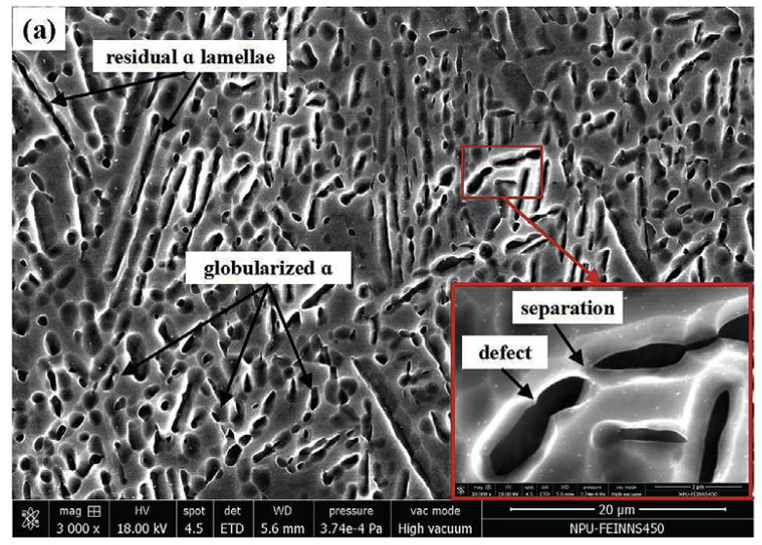
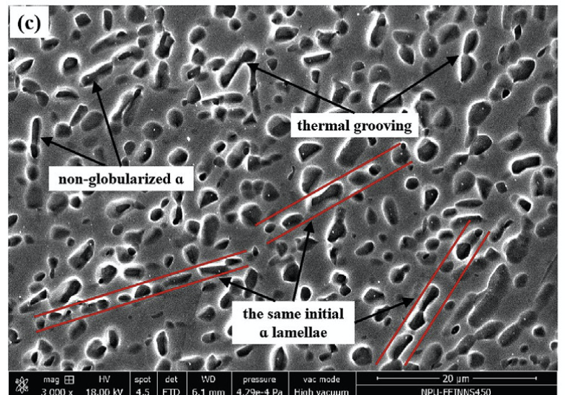
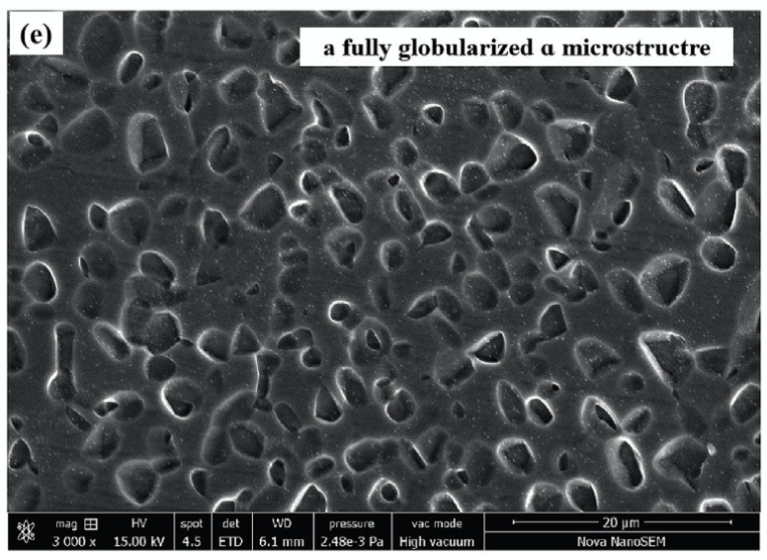
Aims
Develop modelling tools for investigating hot-deformation of dual-phase Ti alloys
Help us to understand:
co-deformation of two phases
texture and microstructural evolution
dynamic transformation: globularisation and grooving
Integration with experimental data

Slide 3
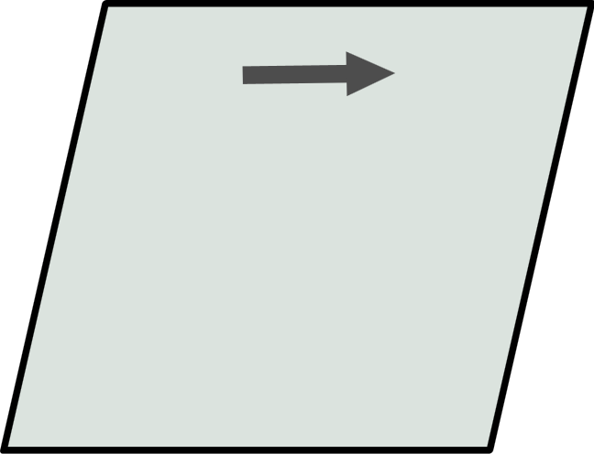
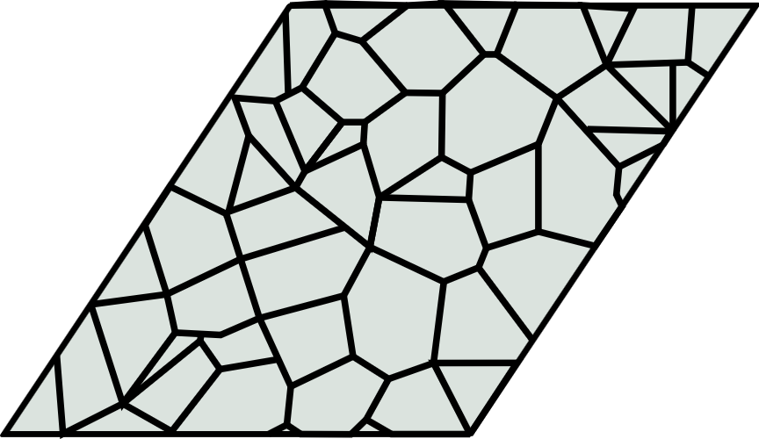
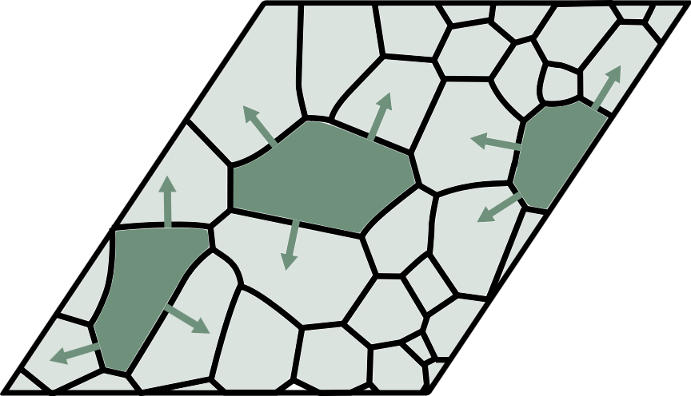
Strategy
Part 1: static modelling
(evolution after deformation)
deform with crystal plasticity (DAMASK)
cluster orientations to identify grains
evolve microstructure with phase field (CIPHER)
Deformation
Recovery
RX
time
Notes:
With static, we impose a recovery structure using reasonable empirical relations (from orientation clustering)

Slide 4
Strategy
Part 1: static modelling
(evolution after deformation)
deform with crystal plasticity (DAMASK)
cluster orientations to identify grains
evolve microstructure with phase field (CIPHER)
Deformation
Recovery
RX
time
time
coupled crystal-plasticity/phase-field model (DAMASK)
Part 2: dynamic modelling
(evolution during deformation)

Slide 5

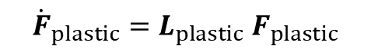
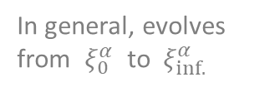
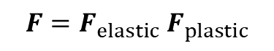
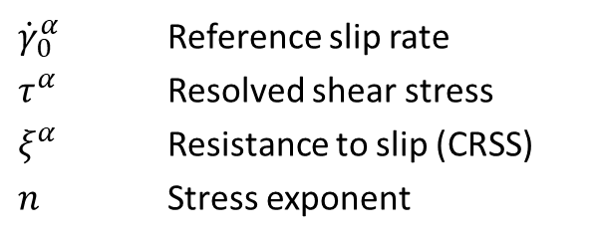
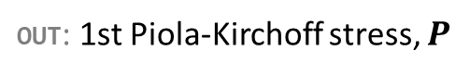
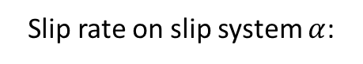
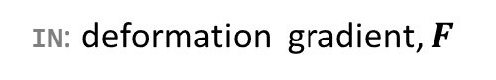
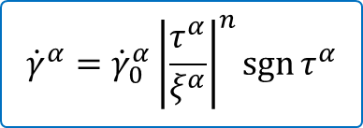
Methods: crystal plasticity (CP)
Finite-strain CP
Generalised material-point continuum model
https://damask.mpie.de/
IN: deformation gradient, $F$
$$F=F_{elastic} F_{plastic}$$
$${\dot{F}}_{plastic}=L_{plastic}{ F}_{plastic}$$
OUT: 1st Piola-Kirchoff stress, $P$
via constitutive law, such as…
Simple phenomenological power law
${\dot{γ}}_{0}^{α}$ Reference slip rate
$τ^{α}$ Resolved shear stress
$ξ^{α}$ Resistance to slip (CRSS)
$n$ Stress exponent
$${\dot{γ}}^{α}={\dot{γ}}_{0}^{α}{\left|\frac{τ^{α}}{ξ^{α}}\right|}^{n}\operatorname{sgn}{τ^{α}}$$
Slip rate on slip system $α$:
In general, evolves from $ξ_{0}^{α}$ to $ξ_{inf.}^{α}$
Notes:
Can change to different laws
Since generalised, we can add in support for phase-field evolution

Slide 6
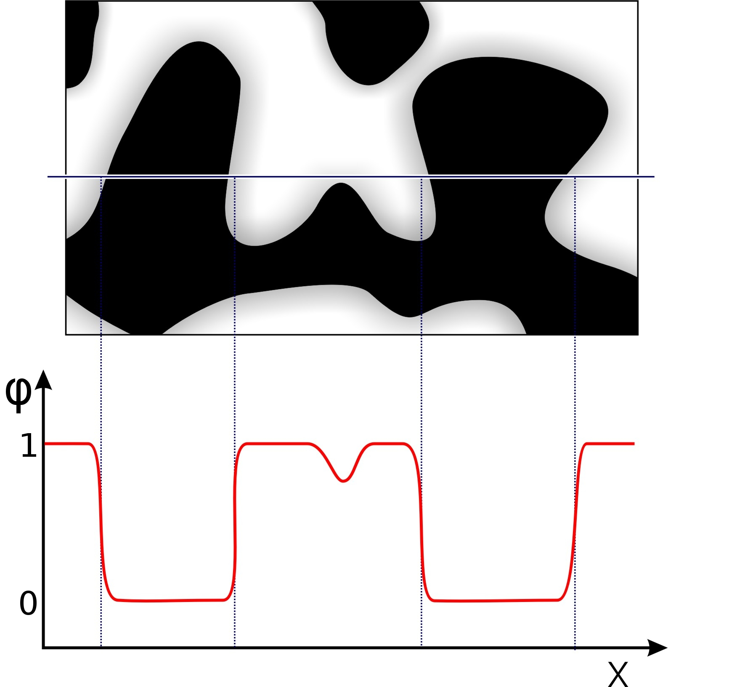
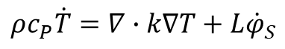
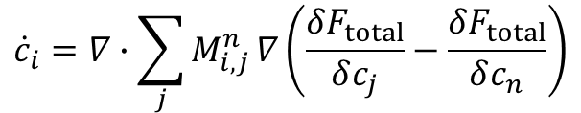
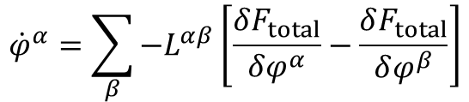
Methods: phase field (PF)
Multi-phase field theory
Microstructure evolution:
$${\dot{φ}}^{α}=\sum_{β}{{−L}^{αβ}\left[\frac{δF_{total}}{δφ^{α}}−\frac{δF_{total}}{δφ^{β}}\right]}$$
Solute diffusion:
$${\dot{c}}_{i}=∇∙\sum_{j}{M_{i,j}^{n}}∇\left(\frac{δF_{total}}{δc_{j}}−\frac{δF_{total}}{δc_{n}}\right)$$
Gibbs energy → CALPHAD databases
Thermal conduction:
Interface mobility → needs to be calibrated
Solute mobility → Diffusion databases/needs calibration
$$ρc_{P}\dot{T}=∇∙k∇T+L{\dot{φ}}_{S}$$
Thermal properties → needs calibration
Notes:
interface mobilities: from diffusion-controlled assumption for growth
solute mobilities/driving forces: from CALPHAD databases
interface energies: probably not so important; transformation driven by stored energy more than capillary effects

Slide 7
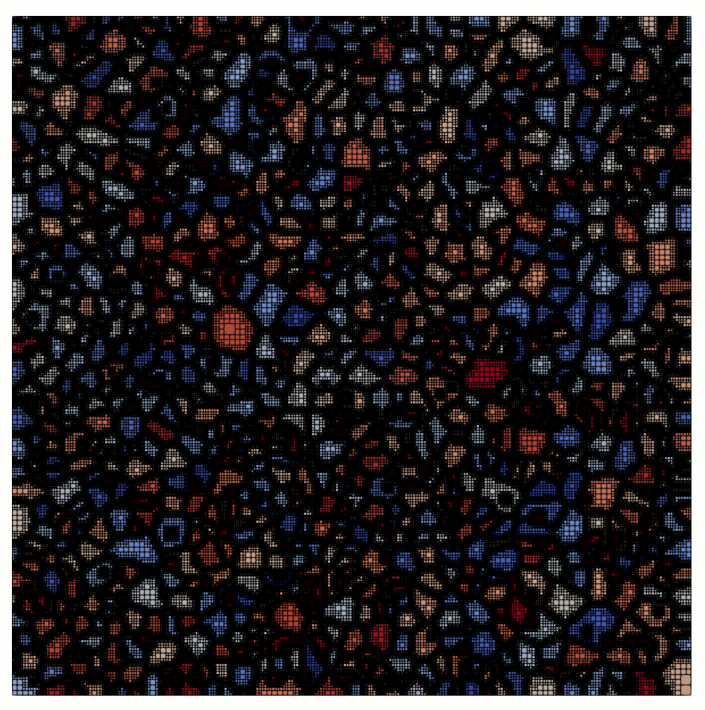
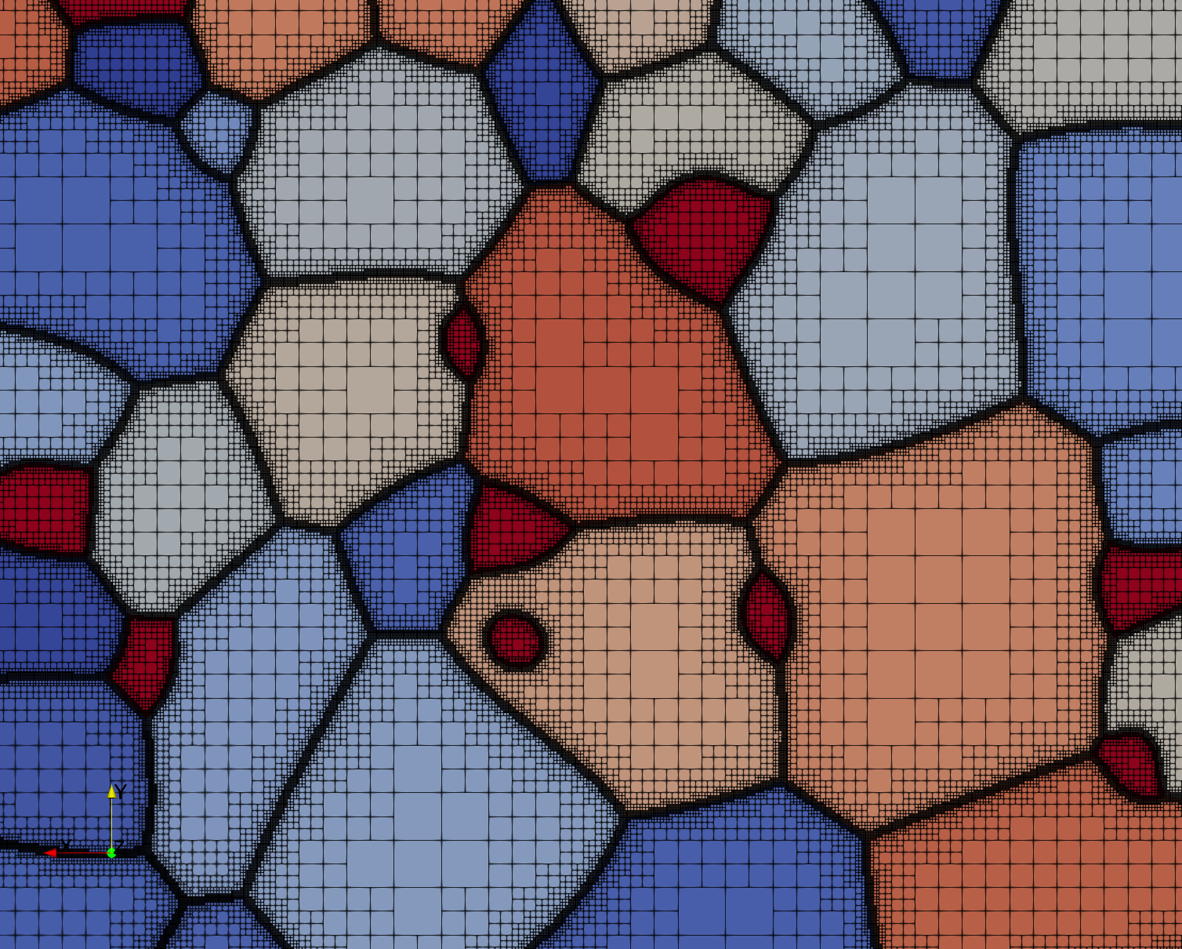
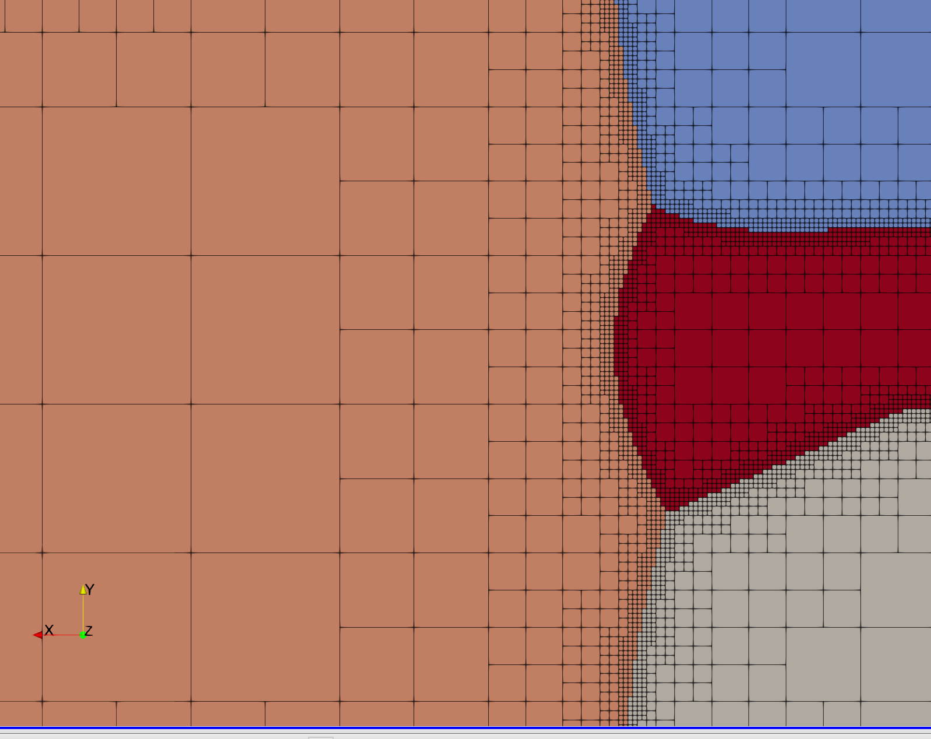
Methods: PF with CIPHER
CIPHER: Phase-field simulation code for microstructure evolution in multi-component alloy systems
Efficient grand-canonical-based phase-field implementation, using:
Compound Energy Formalism
Other CALPHAD thermodynamic models for multi-component system
✔ Automatic parallel adaptive mesh refinement
✔ MPI parallelization and scalability
✔ Large number of phases (10-10,000); constant computational complexity
✔ Local truccation error estimates and adaptive time stepping
✔ Open-source: https://github.com/micmog/CIPHER

Slide 8
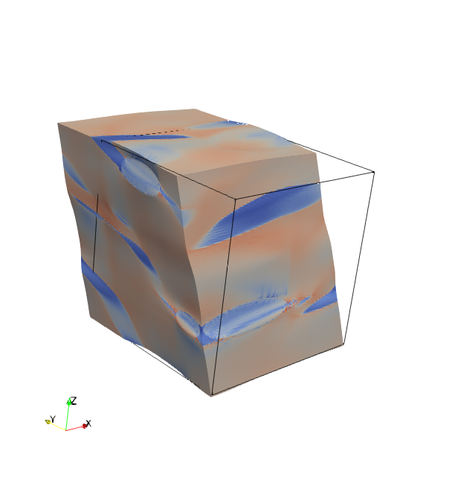

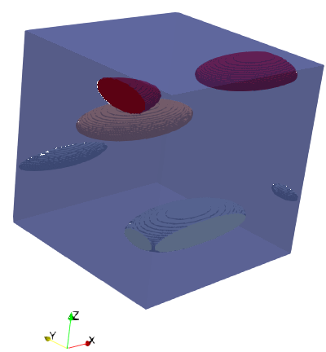
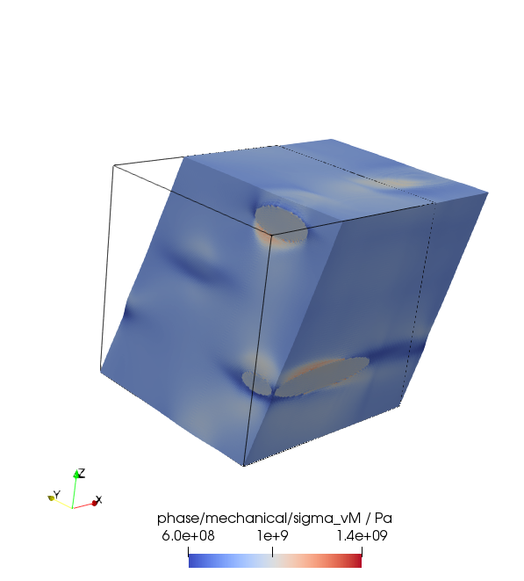


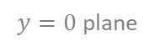
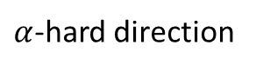
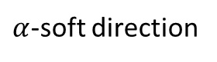
Results: phase-field pre-processing
Orientation clustering
$α$-soft direction
Fast multi-scale clustering
$α$-hard direction
$y=0$ plane
load to 40%
arbitrary colouring
Notes:
Loading direction is one “variable”: lots of others to look at later (e.g. surface roughness, volume fraction, real vs synthetic microstructures)

Slide 9
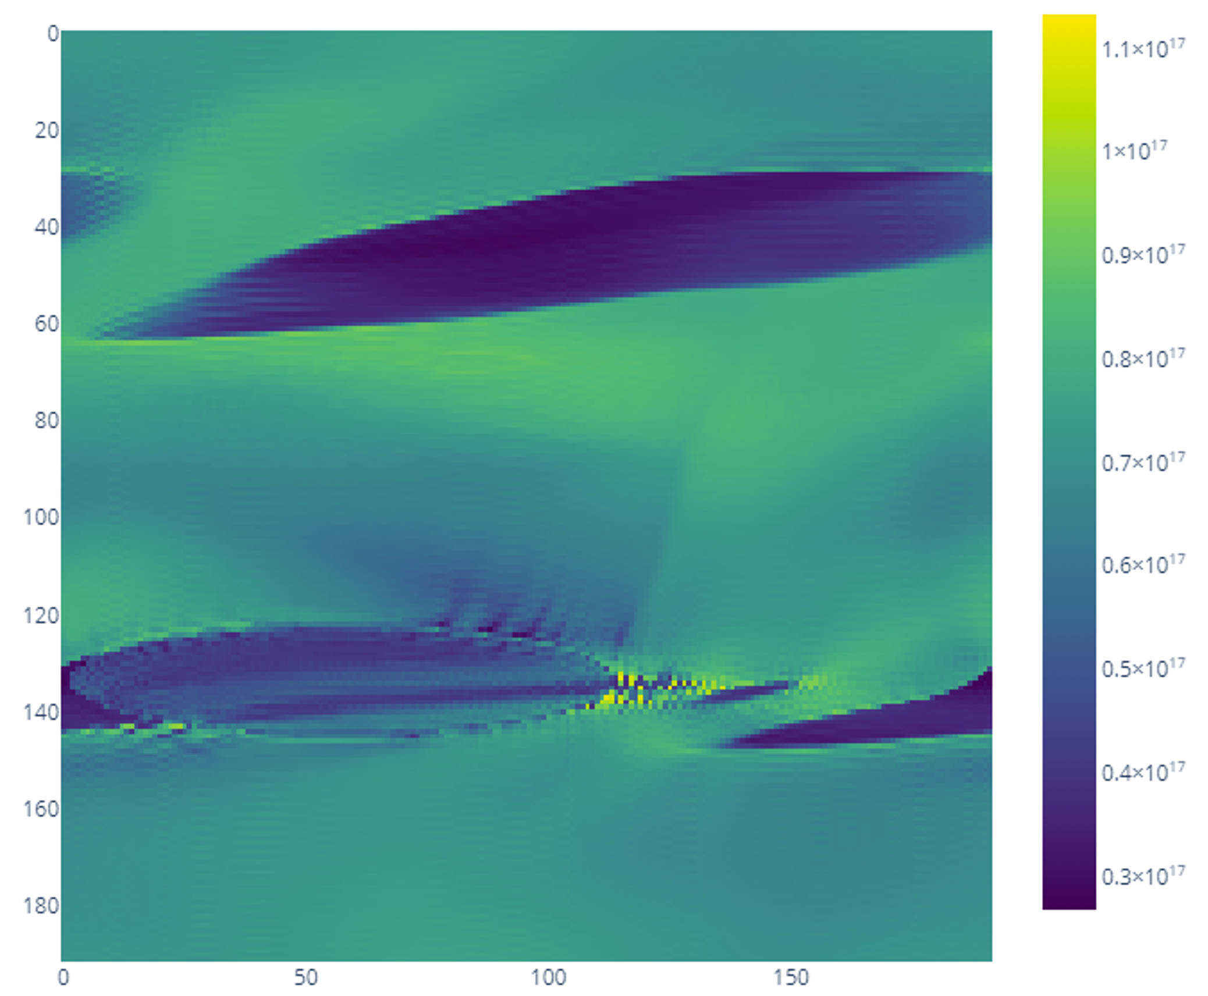
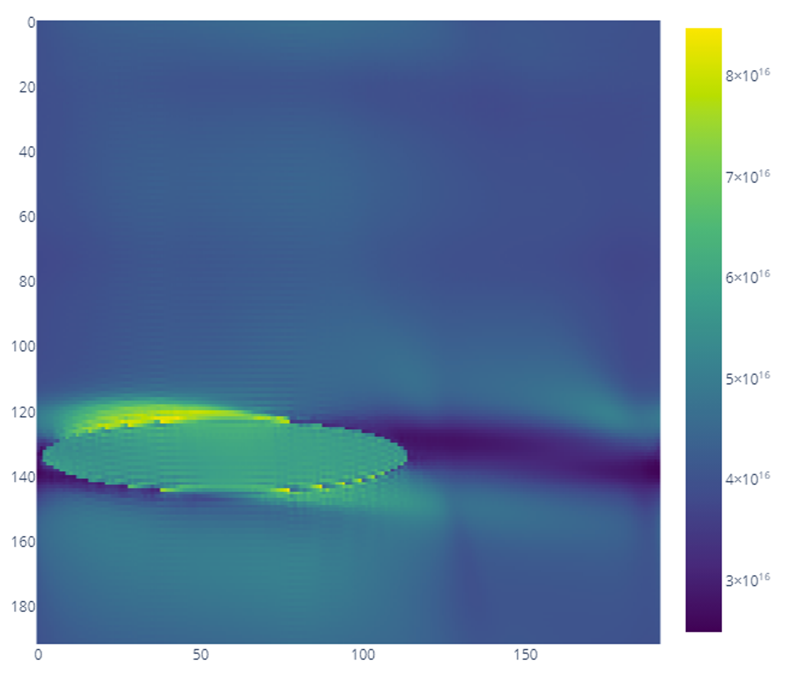
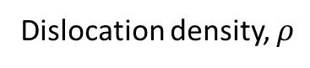
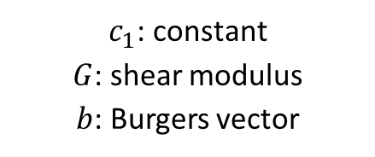
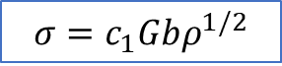
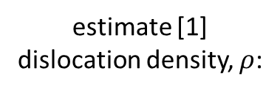
Results: phase-field pre-processing
Dislocation density
Dislocation density, $ρ$
$α$-soft direction
11e16
estimate [1] dislocation density, $ρ$:
3e16
$α$-hard direction
$y=0$ plane
$$σ=c_{1}Gbρ^{1/2}$$
8e16
$c_{1}$: constant
$G$: shear modulus
$b$: Burgers vector
load to 40%
3e16
[1] Empirical equation. See: Humphreys, F. J., and M. Hatherly. ‘Chapter 2 - The Deformed State’. https://doi.org/10.1016/B978-008044164-1/50006-2.
Notes:
$ρ$ perhaps inaccurate due to room temperature single crystal parameters?

Slide 10
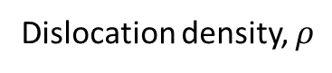

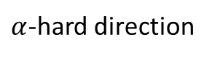
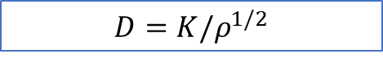
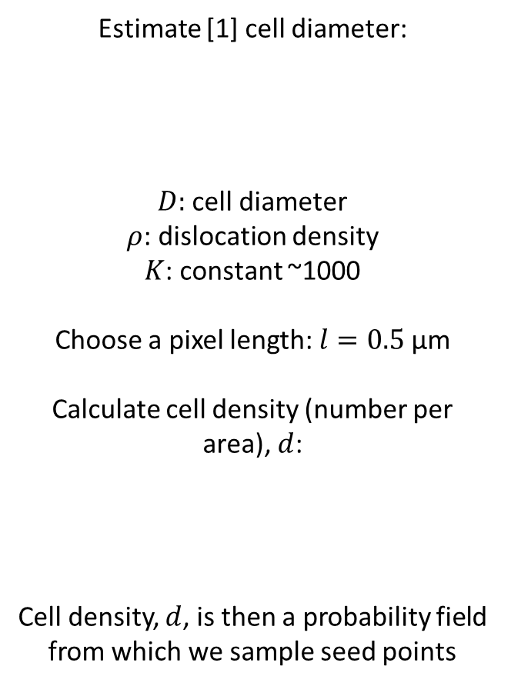
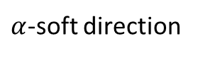
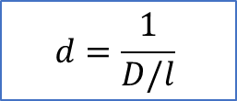
Results: phase-field pre-processing
Tessellation of sub-grains
Estimate [1] cell diameter:
$D$: cell diameter
$ρ$: dislocation density
$K$: constant ~1000
Choose a pixel length: $l=0.5$ μm
Calculate cell density (number per area), $d$:
Cell density, $d$, is then a probability field from which we sample seed points
11e16
$$D=K/ρ^{1/2}$$
$α$-soft direction
3e16
Dislocation density, $ρ$
Clustered grains
$y=0$ plane
$α$-hard direction
8e16
$$d=\frac{1}{D/l}$$
3e16
[1] Humphreys, F. J., and M. Hatherly. Chapter 13 – ‘Hot Deformation and Dynamic Restoration’ https://doi.org/10.1016/B978-008044164-1/50017-7
Notes:
Now want to distribute seed points within each grain, representing the seeds of dislocation cells/sub-grains

Slide 11
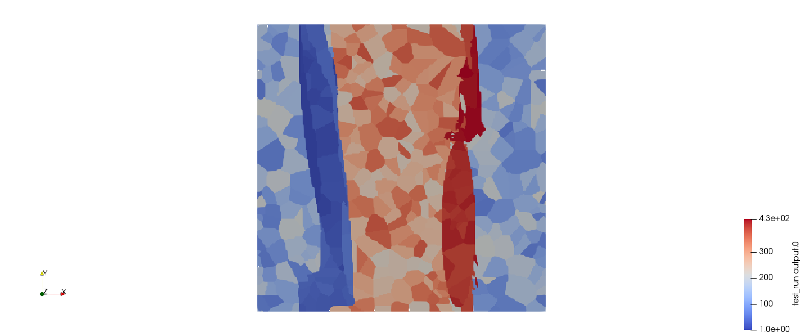
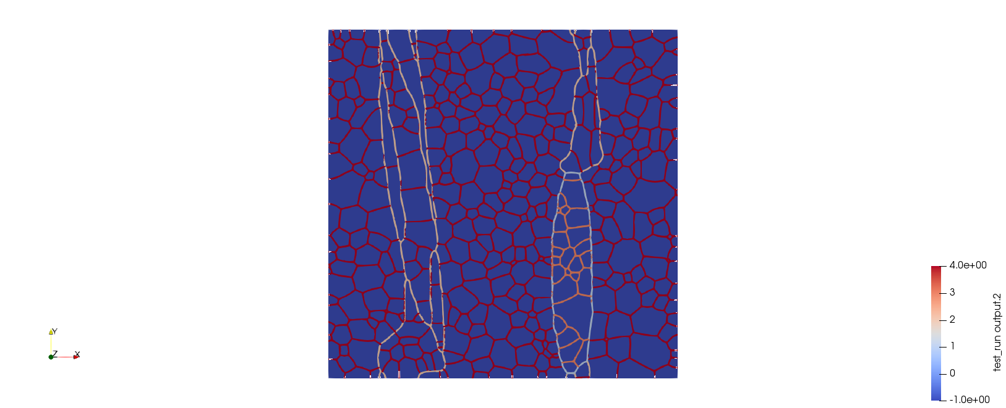
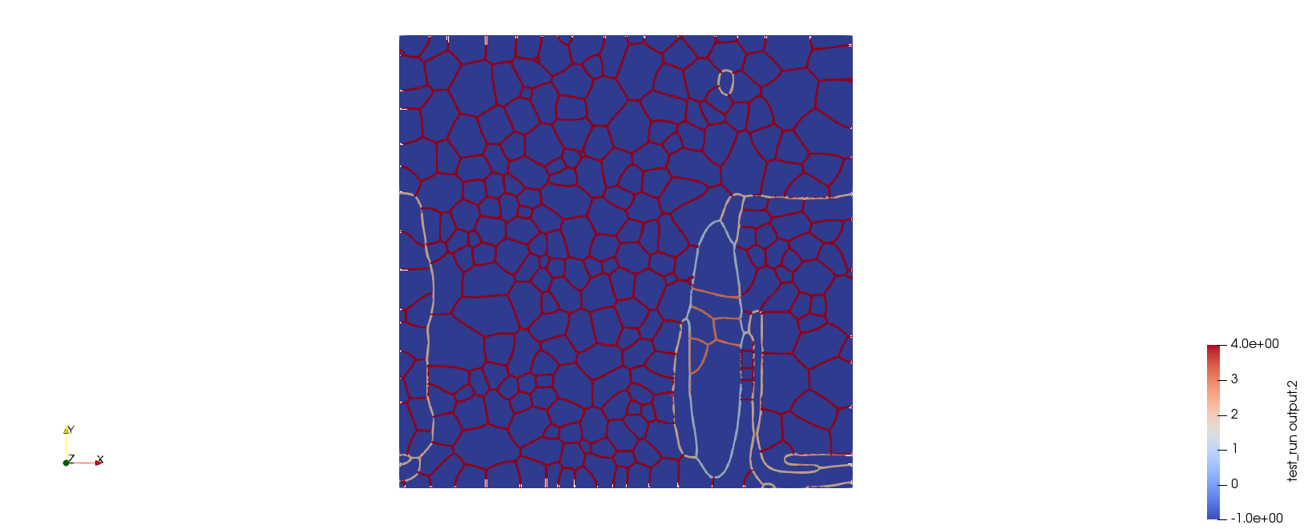
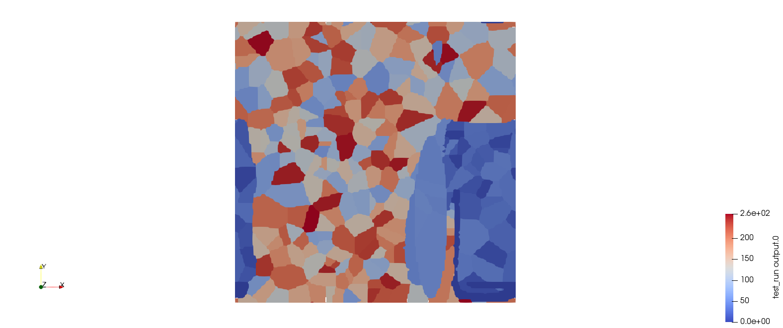
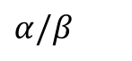
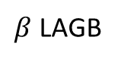
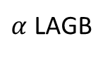
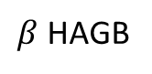
Results: phase-field pre-processing
Tessellation of sub-grains
 | GB energy / J m⁻² | GB mobility / m³ J⁻¹ s⁻¹
HAGB | 0.5 | 1e-11
LAGB | 0.2 | 5e-11
$α$-soft direction
$$α/β$$
$β$ HAGB
$y=0$ plane
interface colouring
$α$ LAGB
arbitrary colouring
$α$-hard direction
$β$ LAGB

Slide 12
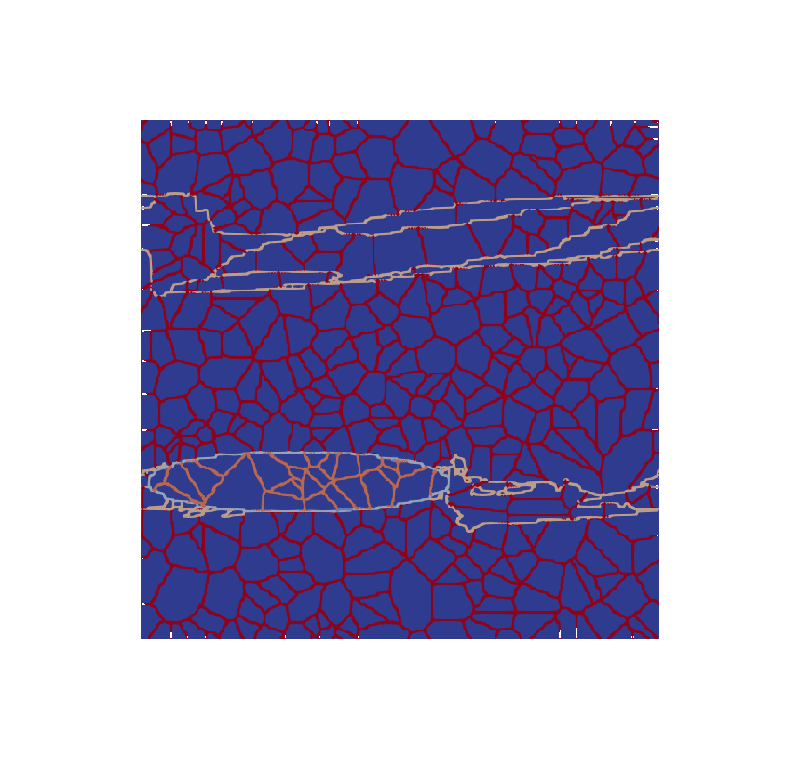
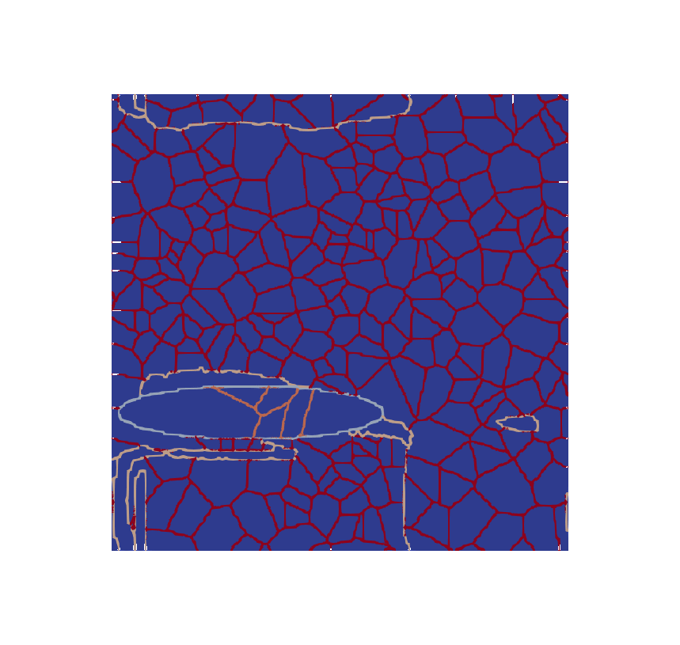
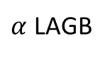





Results: PF grain-growth
Tessellation of sub-grains
$α$-soft direction
$α$-hard direction
interface colouring
$$α/β$$
$β$ HAGB
$α$ LAGB
$β$ LAGB

Slide 13


2022 plan
CIPHER
Part 1: static modelling
Include effect of chemistry (currently just microstructure evolving)
For two phases: growth depends on how fast Al, V are diffusing
Interface mobilities from diffusion-controlled assumption for growth
Synthetic microstructures
Real microstructures
Variables:
Loading directions
Synthetic vs. real microstructures
Surface roughness
Particle volume fraction
Full MatFlow integration for future-proofing
Part 2: dynamic modelling
Extend DAMASK to provide CP/PF coupling
Re-examine investigates from Part 1
Output: paper demonstrating coupled modelling to explain experimental observations (e.g. grooving)

Slide 14


Clustered misorientation distributions
$α$-soft direction
$y=0$ plane
$α$-hard direction

